Slide 1
CLOUD WEBHOSTING & PREVENT FROM SERVER CRASH using (AWS)

Slide 2
ABSTRACT
Traditional on-premises web architectures require complex solutions and accurate reserved capacity forecast in order to ensure reliability. Dense peak traffic periods and wild swings in traffic patterns result in low utilization rates of expensive hardware.
This yields high operating costs to maintain idle hardware, and an inefficient use of capital for underused hardware.
Amazon Web Services (AWS) provides a reliable, scalable, secure, and highly performing infrastructure for the most demanding web applications. This infrastructure matches IT costs with customer traffic patterns in near-real time.
Cloud servers are the best way of operating our websites without any down in our websites , AWS provides the high availability of our hosting at all the regions and our accessible to the website and operation is easy and maintenance can be easily done.

Slide 3
EXISTING SYSTEM
Provide building facility teams a holistic view of building status and performance, alerting them to problems sooner and helping them solve problems faster.
Provide a detailed record of the efficiency and usage of the building over time.
Use historical building data to help optimize building operations and predict maintenance needs.
Offer enriched tenant engagement through services like building control and personalized experiences.
Allow building owners to gather granular usage data from multiple buildings so they can react to changing usage patterns in a single platform.

Slide 4
DEMERITS
Server may crash easily to a small rise in users traffic .
Reliability is not there in the existing system of websites.
Security is not high and can be hacked easily by the bugs and hackers
There is not any automation criteria with the help of autoscaling group in case of any crash occurred to the website hosted
The website hosting becomes a easy job with the AWS console with high security in the security groups and keep confidential the data’s.
The roles can be specified with the aws in the IAM user and permissions can be restricted by the administrator.

Slide 5
Literature survey
Khandelwal Veena et al [1] Time dimension in Amazon EC2 spot instance pricing is decomposed into weekday and hour to study Amazon EC2 spot price dynamics. Statistical tests performed on various compute optimized instances of Linux/UNIX and Windows type.
Minoru Uehara Recently [2]Cloud computing becomes popular. Cloud is used for education. We proposed supersaturation method and developed educational cloud based on supersaturation. In cloud computing, the supersaturation method is a method of assigning a lot of logic resources than the physical resources.
A.Allawi [3]Cloud computing is currently considered one of the fastest-growing businesses in the field of IT. One of cloud computing main benefits is that it can be accessed and managed anytime and from anywhere using the web. In order to allow for such a feature, the cloud service providers offer several development tools and services. This paper shows some of the services offered by AWS.
Davies Aklamati [4] In the last few years, Cloud computing technology has benefited many organizations that have embraced it as a basis for revamping the IT infrastructure. Cloud computing utilizes Internet capabilities in order to use other computing resources. Amazon Web Services (AWS) is one of the most widely used cloud providers that leverages the endless computing capabilities that the cloud technology has to offer.

Slide 6
Syed R Rizvi et al. [5] Open Data Cube (ODC) initiative, with support from the Committee on Earth Observation Satellites (CEOS) System Engineering Office (SEO) has developed a state-of-the-art suite of software tools and products to facilitate the analysis of Earth Observation data. This paper presents a short summary and cost analysis of our experience using Amazon Web Services (AWS) to host one such software product, the CEOS Data Cube (CDC) web-based User Interface (UI).
He-Sheng Wu et al. [6] Load balancing is the core of virtual resource management and scheduling in cloud computing. For network applications, the cost of user would be greatly saved if load balancer could dynamically adjust cluster resources in accordance with the current applied load. The current load balancing products of cloud, such as Amazon's ELB, can be used to manage virtual machines in the cloud.
Nnamdi Ekwe-Ekwe et al. [7] Cloud computing is a ubiquitous part of the computing landscape. For many companies today, moving their computing infrastructure to the cloud reduces time to deployment and saves money. Spot Instances, a subset of Amazon's cloud computing infrastructure (EC2), expands upon this. They allow a user to bid on spare compute capacity in EC2 at heavily discounted prices. If other bids for the spare capacity exceeds the user's own, the user's instance is terminated. In this paper, we conduct one of the first detailed analyses of how location affects the overall cost
Khandelwal Veena et al. [8] Time dimension in Amazon EC2 spot instance pricing is decomposed into weekday and hour to study Amazon EC2 spot price dynamics. Statistical tests performed on various compute optimized instances of Linux/UNIX and Windows type show that weekday dimension in time hierarchy is as important as hour dimension in describing spot price dynamics. The main drawbacks are still only supporting template-based deployment of new virtual machines, not supporting the trend prediction, failing to gain resources dynamically.

Slide 7
Artur Cepuc et al. [9] Nowadays, cloud computing has become the go to solution for most enterprises. This has led to the introduction of DevOps techniques in which developers work closely with network engineers in order to ensure fast and reliable deployment of their applications. This paper presents an entire automated pipeline. Kubernetes cluster to host this new version and finally deploying the containerized application in AWS.
Beaulah A. Navamani et al. [10] Cloud computing offers the potential for productivity, cost savings and innovation advantages to organizations. To utilize these benefits, to facilitate wide-scale cloud adoption and to embrace cloud computing, we must address many clouds security challenges. Attackers can compromise the vulnerable hosts and can either take over their resources or use them as stepping stones for future attacks. Open ports can be the most prominent gateway for many threats and potential attacks
Yongmin Kim Soo et al. [11] This study analyzed the ongoing drought situation in South Korea using MODIS satellite data and AWS ground observation data. In order to analyze the drought, the Scaled Drought Condition Index (SDCI) was calculated utilizing concurrent precipitation, temperature and vegetation factors. Unlike conventional research that utilizes only satellite data, we utilized AWS ground-based observation data that has advantages in terms of data accuracy and collection stability.
Nicholas Okita et al [12] Cloud computing platforms offer a wide variety of computational resources with different performance specifications for different prices. In this work, we experiment how Spot instances and Availability Zones on the Amazon Web Services (AWS) could be utilized to reduce the processing cost. Not only that, but we propose an instance management algorithm in AWS

Slide 8
Geetha Vinayagam et al. [13] In the last few years, Cloud computing technology has benefited many organizations that have embraced it as a basis for revamping the IT infrastructure. Cloud computing utilizes Internet capabilities in order to use other computing resources. Amazon Web Services (AWS) is one of the most widely used cloud providers that leverages the endless computing capabilities
Ravi Kishore Kodali et al [7] Internet of Things (IoT) is a technology which is rapidly growing, the future of IoT is limitless as the data streams have quadrupled over the years. Future markets are going to shift from traditional data processing techniques to Big Data Analytics and Cloud computing as businesses worldwide are shifting to cloud-based work approaches which was largely boosted by the Covid-19 pandemic.
Ranjith Ramesh et al. [15] The aim of the project is to develop a Machine Learning model to perform predictive analytics on the banking dataset. The banking data set consists of details about customers like and whether the customer will buy a product provided by the bank or not. The data set is obtained from University of California Irvine Machine Learning Repository.

Slide 9
PROPOSED SYSTEM
AWS Cloud console management provides various and different kinds of operations for the execution maintenance of web hosting and managing system
This console gives the elaborate and easy way of creating and hosting the websites with secure method
This web hosting uses different consoles like Route 53, Cloud watch, EC2 instance ,Load balancer , Auto scaling , S3 , RDS .
The website created in the cloud will be highly available and can run without any server down issue . The server health is checked and will be maintained in good health
The logs can be stored for every user hitting the website and any malfunction or issue is created it will sorted out with the help of logs .
We can remotely maintain the server with the prior notification.

Slide 10
ALGORITHM USED
Factorization Machines Algorithm, K-Nearest Neighbors (k-NN) Algorithm, Linear Learner Algorithm, XGBoost Algorithm
DeepAR Forecasting Algorithm
Object2Vec Algorithm
Principal Component Analysis (PCA) Algorithm
Random Cut Forest (RCF) Algorithm
IP Insights
Latent Dirichlet Allocation (LDA) Algorithm, Neural Topic Model (NTM) Algorithm
BlazingText algorithm
Sequence-to-Sequence Algorithm

Slide 11
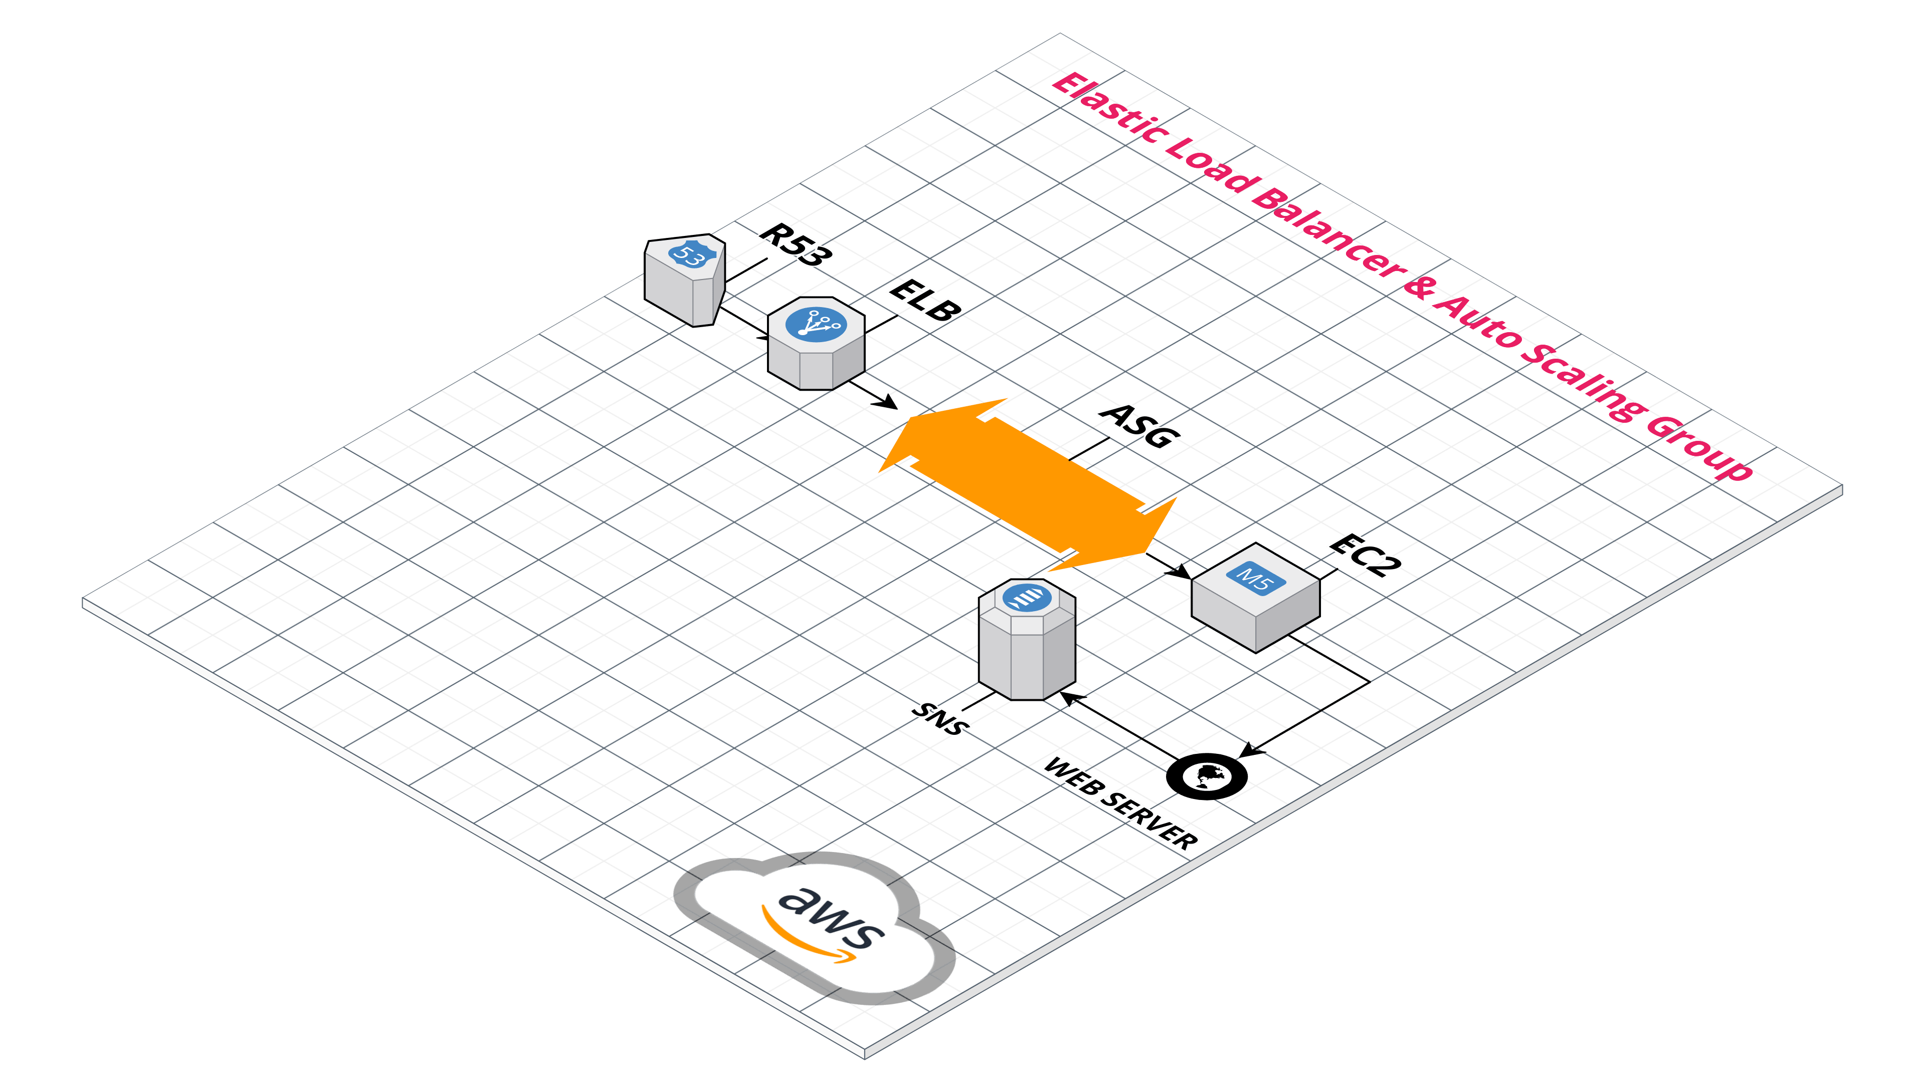
ARCHITECTURE DIAGRAM

Slide 12
COMPONENTS IN ARCHITECTURE DIAGRAM
Route 53
Elastic Load Balancer (ELB)
Auto Scaling Group (ASG)
Amazon EC2
Web Server
Simple Notification Service (SNS)

Slide 13
MODULES
Operational Excellence
The operational excellence pillar focuses on how you can continuously improve your ability to run systems, create better procedures, and gain insights.
Security
The security pillar focuses on how to secure your infrastructure on the cloud. Security and compliance is a shared responsibility between AWS and the customer.
Reliability
The reliability pillar focuses on how you can build services that are resilient to both service and infrastructure disruptions.
Performance Efficiency
The performance efficiency pillar focuses on how you can run services efficiently and scalably in the cloud.
Cost Optimization
The cost optimization pillar helps you achieve business outcomes while minimizing costs.

Slide 14
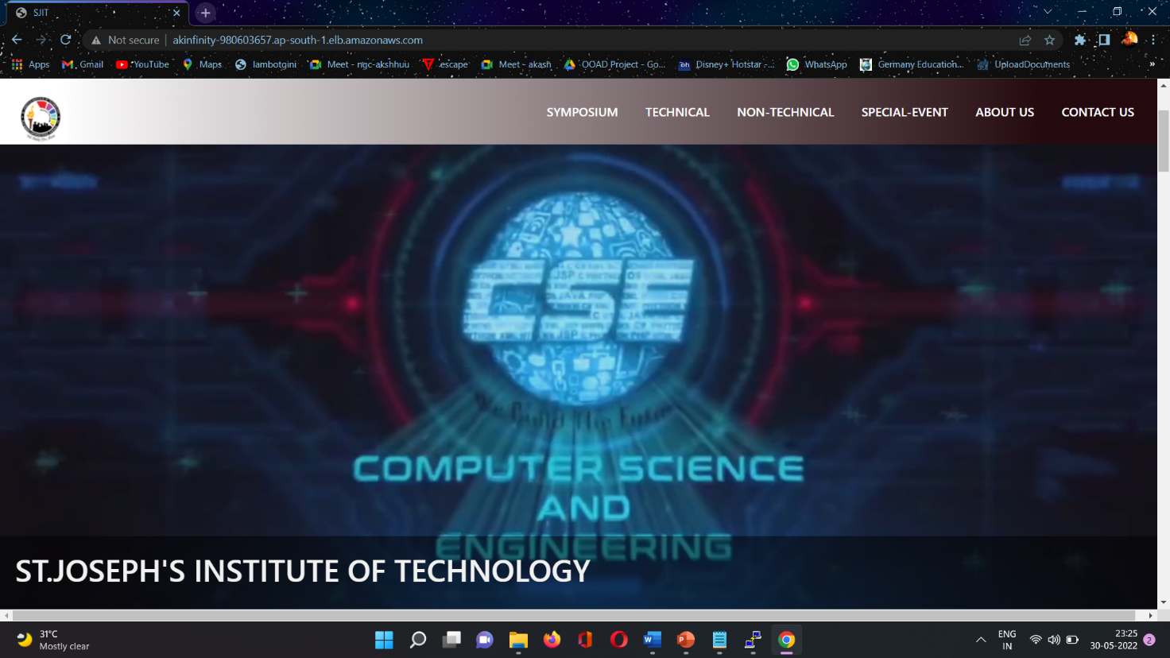
OUTPUT
Website is hosted in the specified domain.

Slide 15
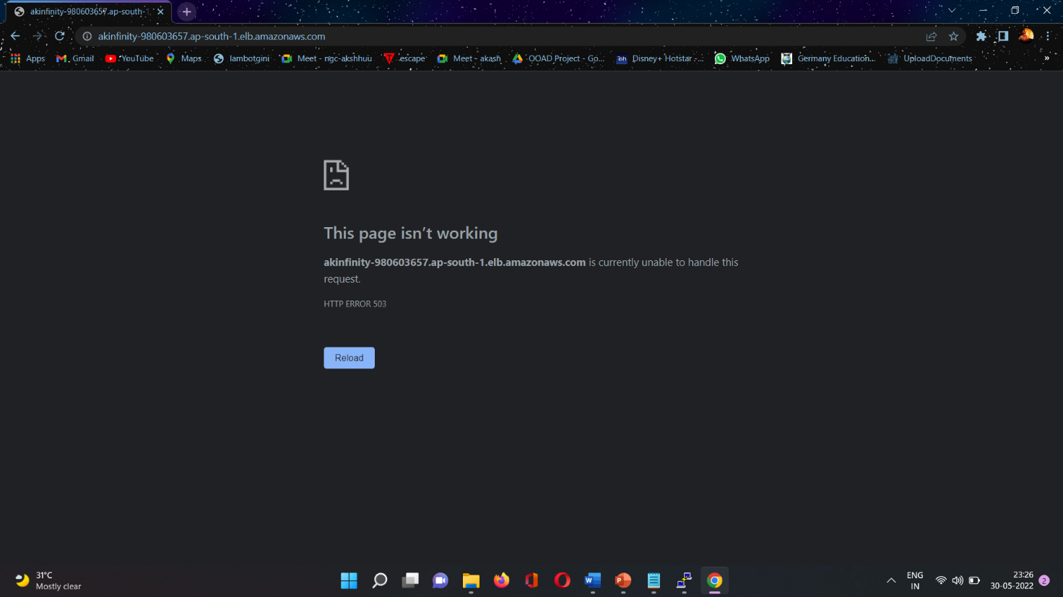
Server is crashed because for high traffic, Now the health checkup will trigger the auto scaling group to create another machine.

Slide 16
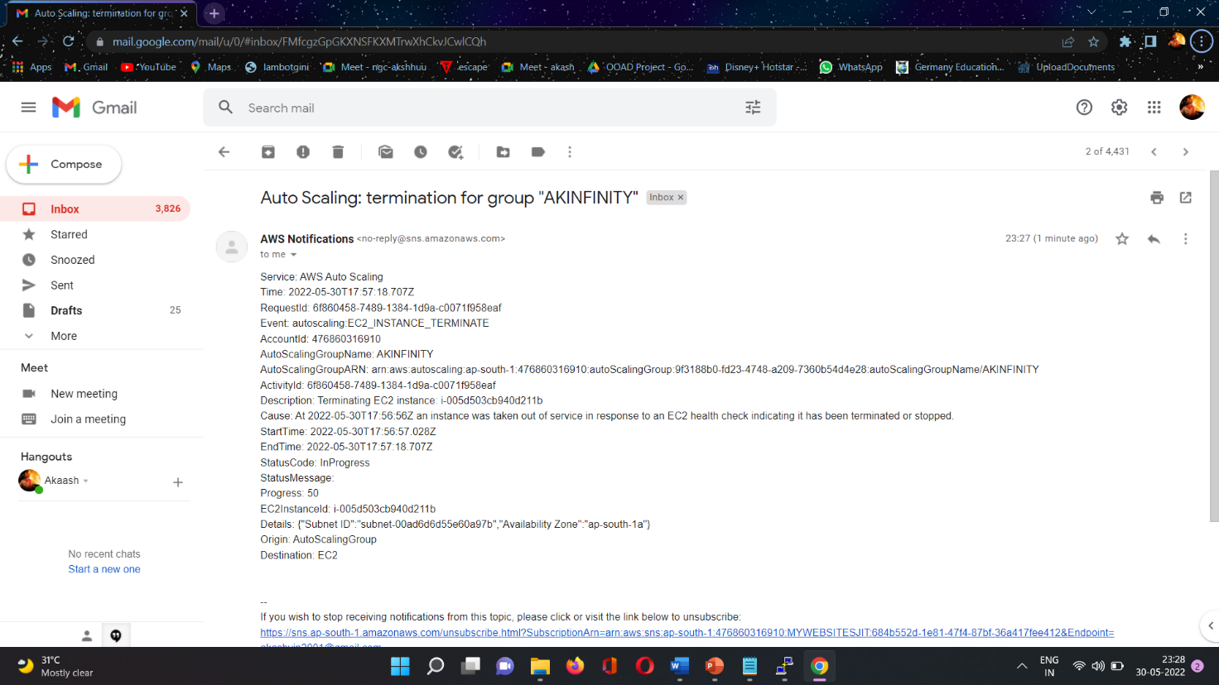
The SNS pops the indication that instance under ASG is terminated.

Slide 17
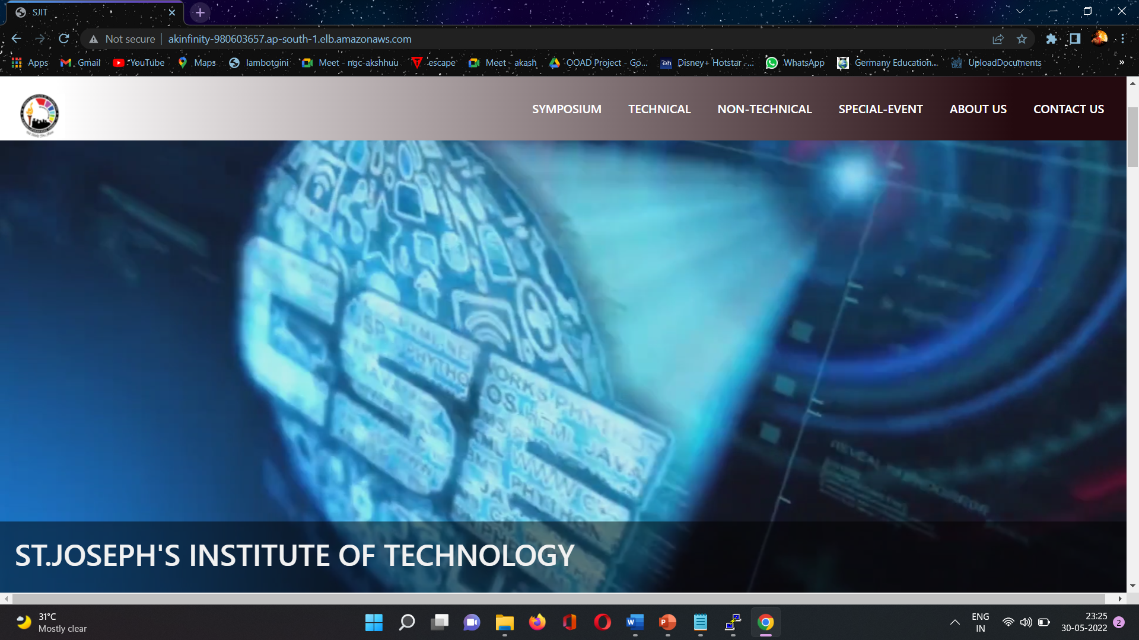
Auto scaling group triggered the instance a new machine with the hosted website.

Slide 18
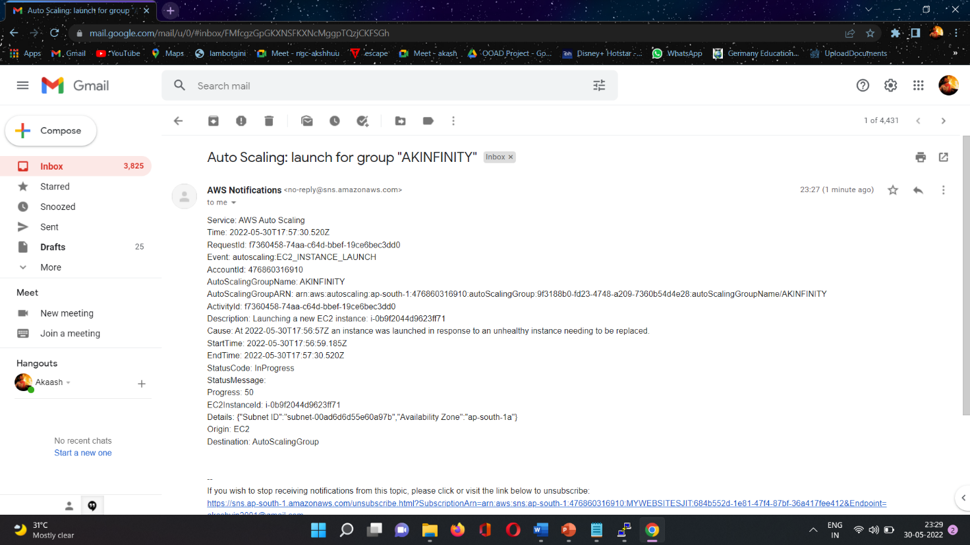
SNS notification of newly launched instance under the autoscaling group

Slide 19
CONCLUSION
This project clearly explains the website can be hosted with the perfect way of web hosting in the AWS , the architecture build here will help you to maintain the server so highly available and be reliable ,this way we can build any site with out any server error or server lag or server down , in straight forward this project will build any website without any server down issue .
There are numerous architectural and conceptual considerations when you are contemplating migrating your web application to the AWS Cloud. The benefits of having a cost-effective, highly scalable, and fault-tolerant infrastructure that grows with your business far outstrips the efforts of migrating to the AWS Cloud.

Slide 20
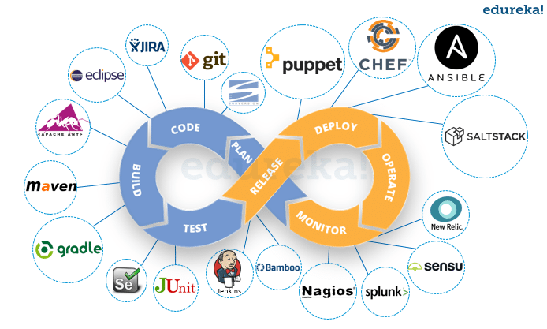
ENHANCEMENT
The main enhancement can be done in this structure is AUTOMATION , the creation of server and hosting which is done in manually cane automated by triggering it.
The automation can be done by different tools called git , Jenkins , docor ,terraform by using this we can automate the full process. This automation is called DEVOPS.

